Slide 1
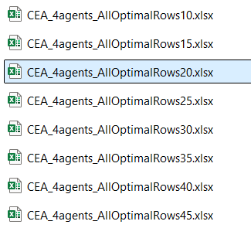
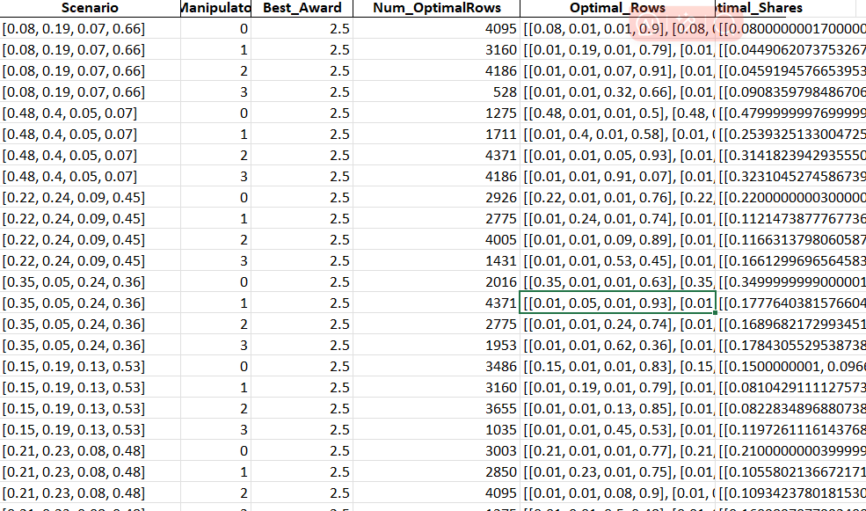
E=10 too small no improvement

Slide 2
0.01 column prediction
Predict-0.01 code is designed for fast strategic insight: it estimates the optimal number of opponents (denoted k) a manipulator should reduce to a minimum report value (e.g., 0.01) in order to maximize their own award under the CEA mechanism. It systematically enumerates all combinations of k floored agents (from 1 to n−2), and distributes the remaining probability mass among the unfloored opponents proportionally to their original share.

Slide 3
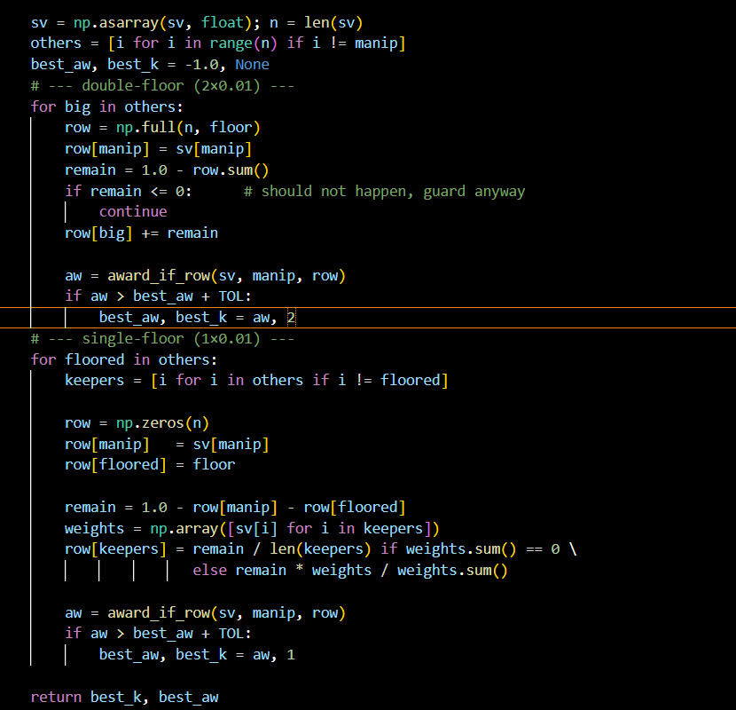
Code for determine how many 0.01 will be
Four agents case:
Return (k, best_award):
k ∈ {1,2} – optimal row contains how many entries equal to floor (=0.01)
Strategy space reduced to:
* double‑floor: [self, f, f, 1‑self‑2f] (who gets the big chunk varies)
* single‑floor: [self, f, α, β] (one floor, rest proportional to truthful)
Other parts are the same: first ID and then CEA

Slide 4
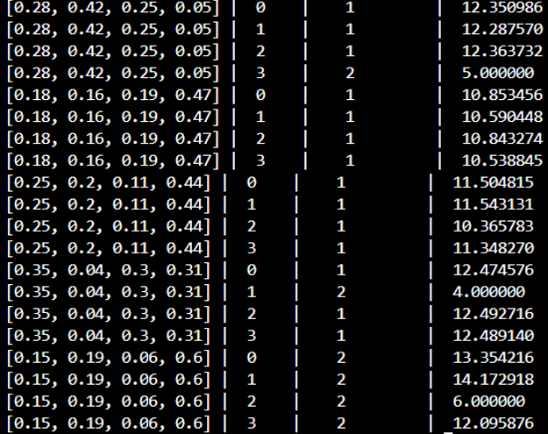
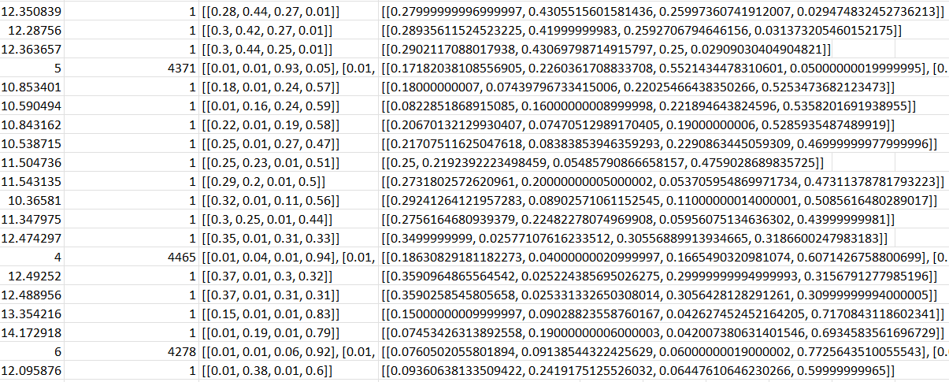
E=40

Slide 5
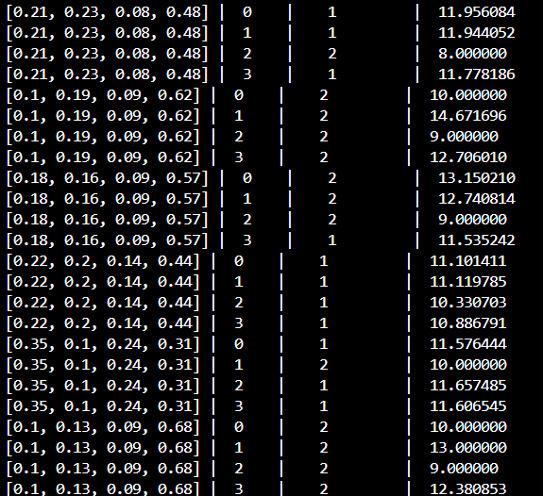
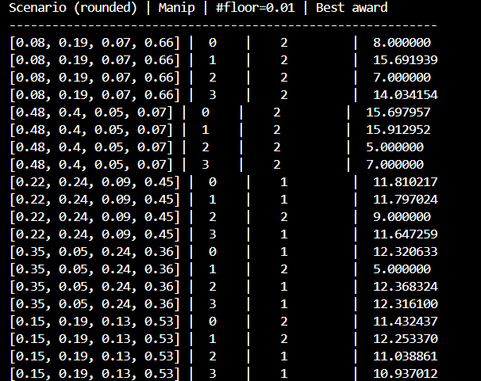

Slide 6
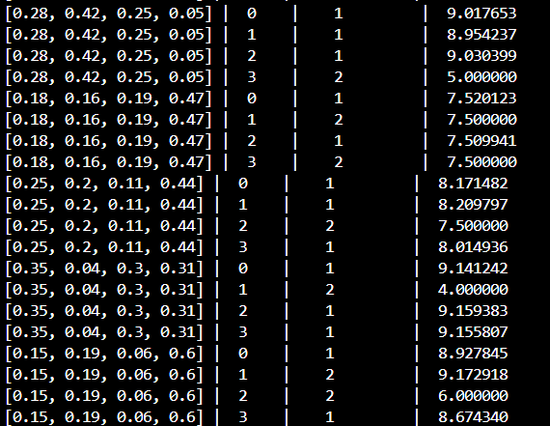
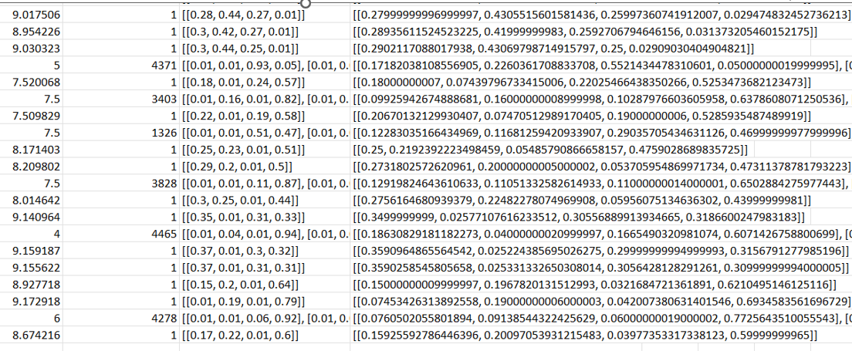
E=30

Slide 7
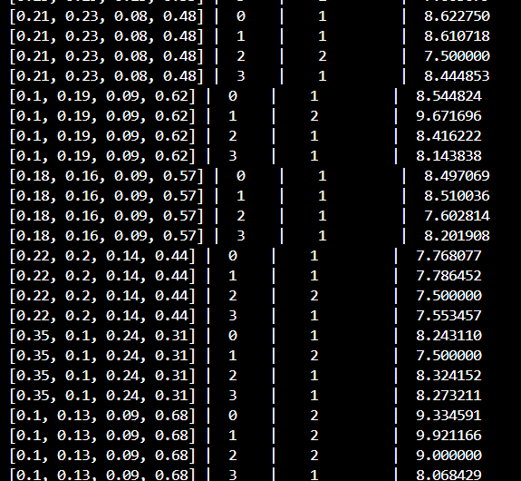
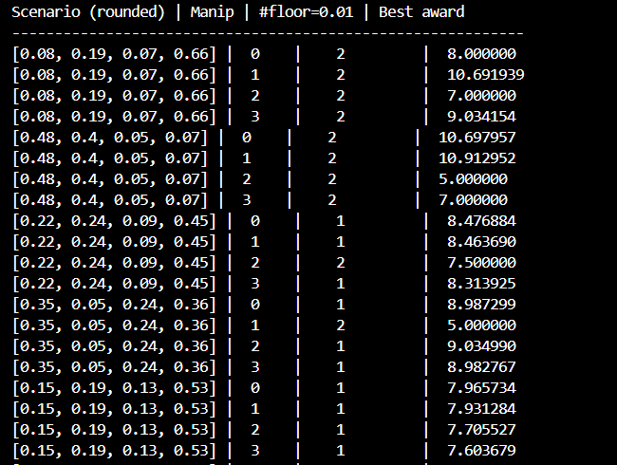

Slide 8
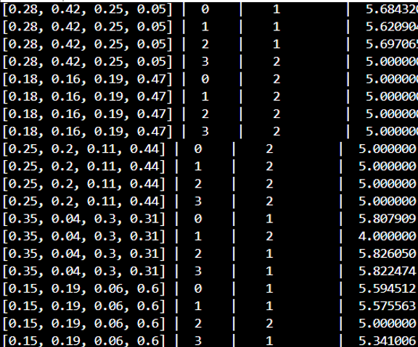
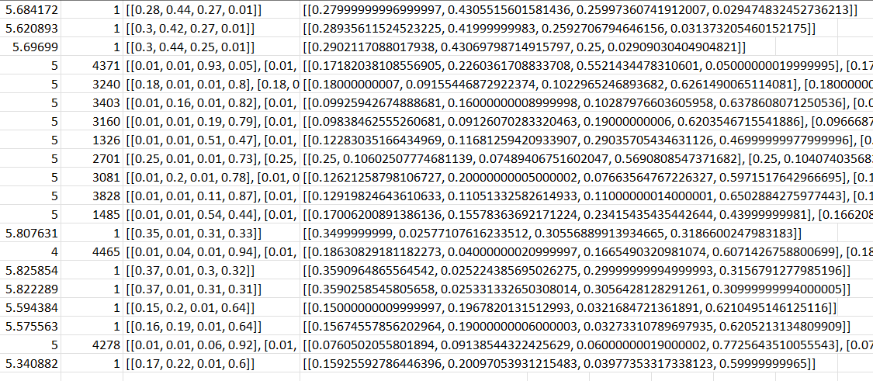
E=20

Slide 9
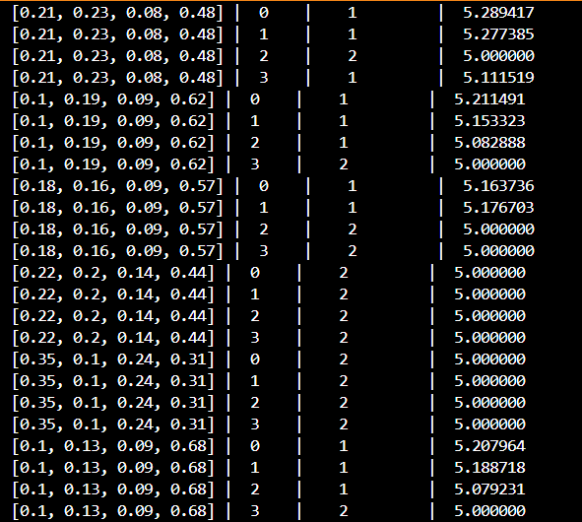
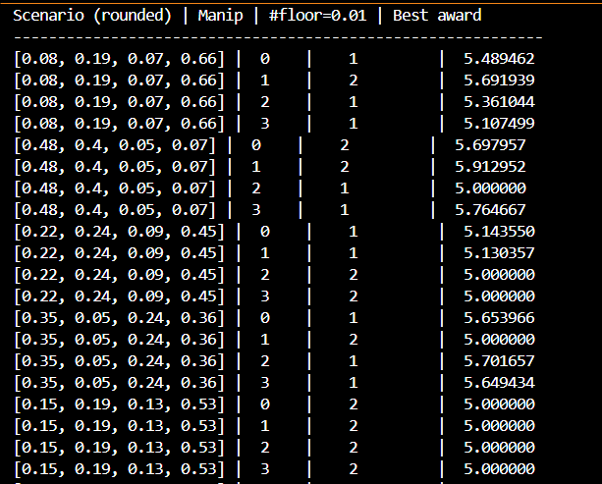

Slide 10
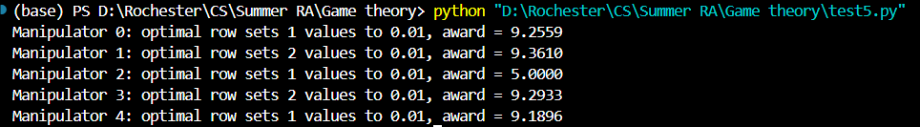
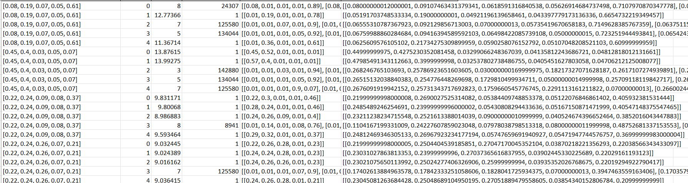
Five- agents case

